Slide 1
19th Century University Life
BY Olivia Deveau

Slide 2

During the years prior to the 19th century, education was available only to the higher classes.
Males were usually the only people who attended universities, so the campuses of universities were usually all-male.

Slide 3
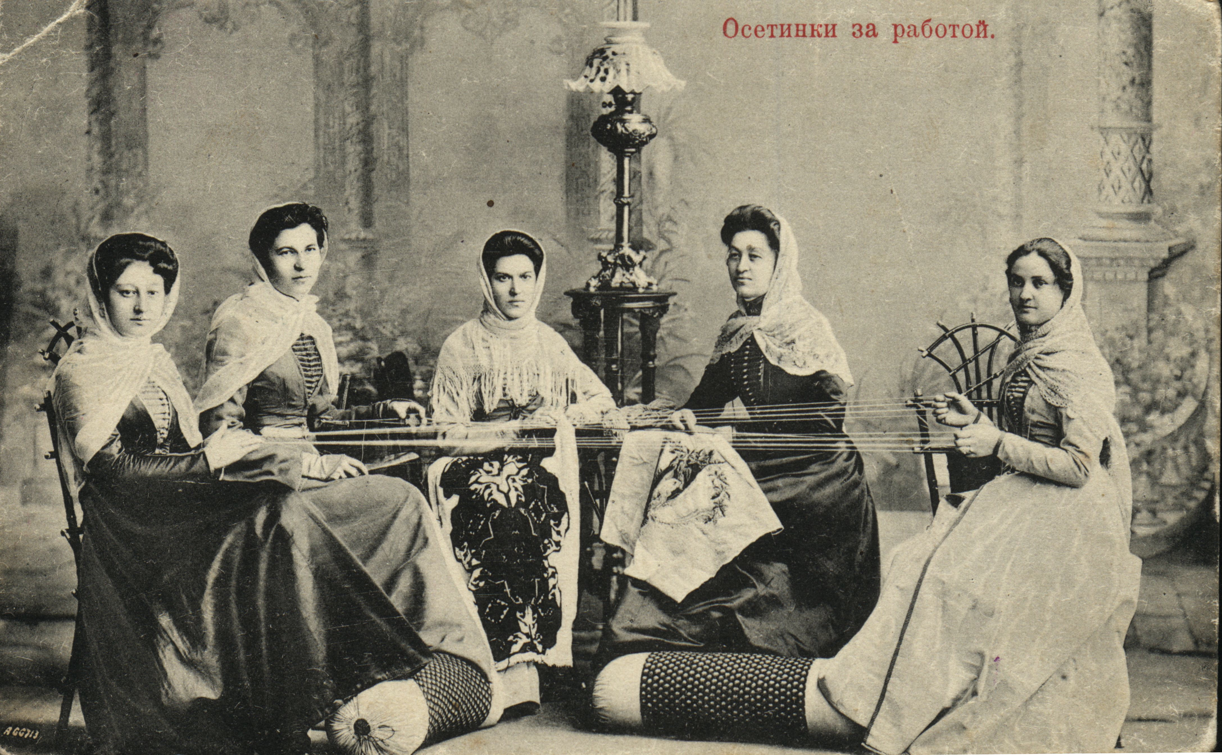

However, during the 19th century, there was a shift in gender roles.
There was also a development of a working class of people throughout Europe.

Slide 4
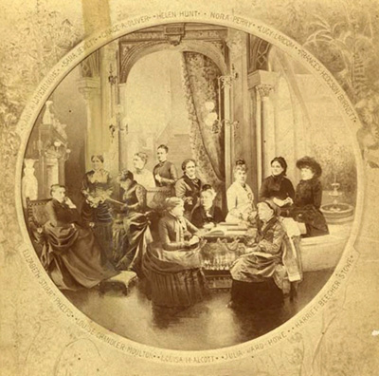
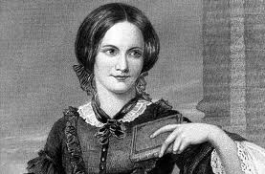
Women’s Roles in the 19th Century
There were many different organizations, or women’s movements.
The International Congress of the Rights of Women that was held during the Paris Exposition in 1878 was one of these meetings, and almost jump-started these movements.

Slide 5
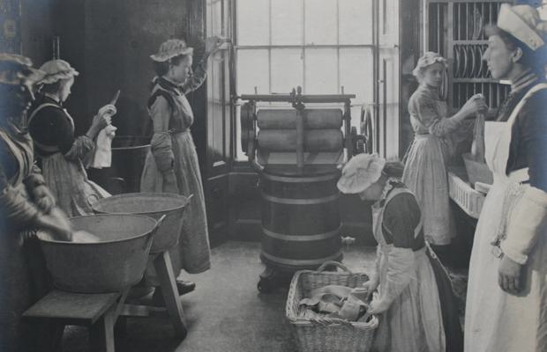
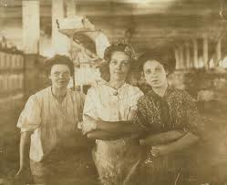
There were also significant changes in women’s employment as more and more women joined the trade union movement, which wanted equal pay and working conditions for women.
The proportion of women who worked for pay was highest in France at 40%

Slide 6
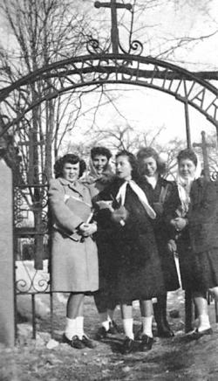
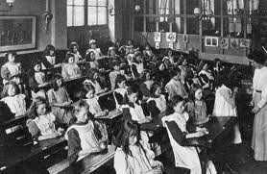
During the 19th century, education became compulsory and free, meaning that more women (and lower-class men) could attend elementary school.
This helped to open up new jobs for women such as book keepers, office clerks, and secretaries.

Slide 7

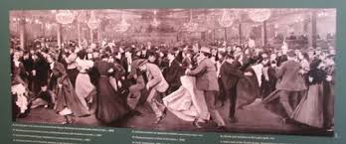
During the 19th century, a mass culture developed, which contributed to the ability of women to attend school.
Women took part in mass leisure and culture as well, which helped to integrate them into society as independent citizens.

Slide 8
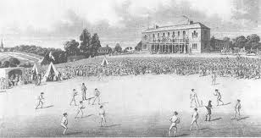
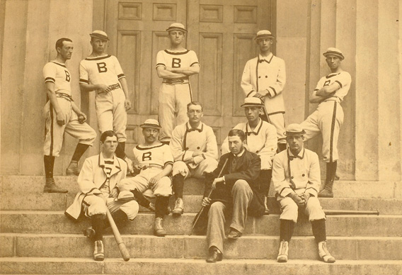
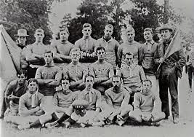
During this time, sporting events became popular outing-destinations, and the elite schools of Britain emphasized athletics.
Spectators would pay to see university games like cricket, or rugby.

Slide 9
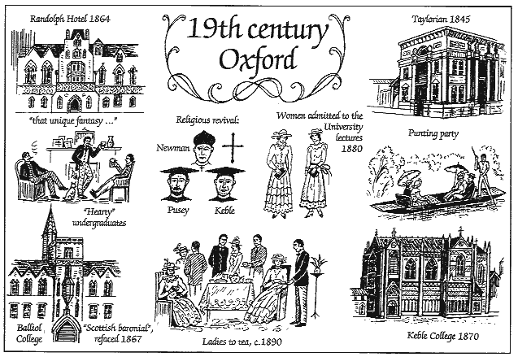
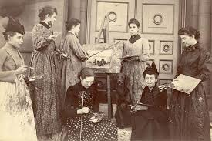
During the 19th century, many universities opened their doors to women for the first time, including Oxford University in England.

Slide 10
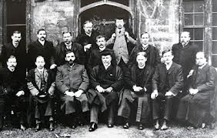
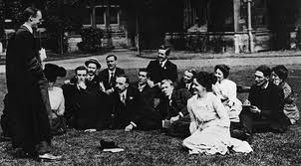
During the 19th century, access to university education grew.
This contributed to a higher literacy rate, and by 1900 more than 90% of the adult population of Germany, France, and Great Britain was literate.
Women-only colleges opened up as well, making university life even more accessible to them.

